Slide 1
4 Hour Worker Training for Fire Protection & Fire Watch
This material was produced under grant number SH-37125-SH1 from the Occupational Safety and Health Administration, U.S. Department of Labor. It does not necessarily reflect the views or policies of the U.S. Department of Labor, nor does mention trade names, commercial products, or organizations imply endorsement by the U.S. Government.
Notes:
This material was produced under grant number SH-37125-SH1 from the Occupational Safety and Health Administration, U.S. Department of Labor. It does not necessarily reflect the views or policies of the U.S. Department of Labor, nor does mention trade names, commercial products, or organizations imply endorsement by the U.S. Government.

Slide 2
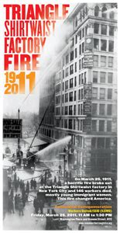
Learning Objectives
Recognition of fire hazards for Workers
General requirements for fire safety
Responding to fires
Types of fire fighting equipment
Fire hazards related for welding and cutting
Fire watch for Field Operations
Notes:
One hundred years ago on March 25, fire spread through the cramped Triangle Waist Company garment factory on the 8th, 9th and 10th floors of the Asch Building in lower Manhattan. Workers in the factory, many of whom were young women recently arrived from Europe, had little time or opportunity to escape. The rapidly spreading fire killed 146 workers.

Slide 3
Fire Protection
1926.150 Fire protection
General requirements.
(1) The employer shall be responsible for the development of a fire protection program to be followed throughout all phases of the construction and demolition work, and he shall provide for the firefighting equipment as specified in this subpart. As fire hazards occur, there shall be no delay in providing the necessary equipment.
(5) As warranted by the project, the employer shall provide a trained and equipped firefighting organization (Fire Brigade) to assure adequate protection to life.
1926.155 Definitions applicable to this subpart
(e) Fire brigade means an organized group of employees that are knowledgeable, trained, and skilled in the safe evacuation of employees during emergency situations and in assisting in fire fighting operations.
Employer Requirements
Access to equipment
Located for easy access
Inspection of equipment
Fire brigades
Access to water supply
Notes:
The employer shall be responsible for the development of a fire protection program to be followed throughout all phases of the construction and demolition work, and he shall provide for the firefighting equipment as specified in this subpart. As fire hazards occur, there shall be no delay in providing the necessary equipment.
Access to all available firefighting equipment shall be maintained at all times.
All firefighting equipment, provided by the employer, shall be conspicuously located.
All firefighting equipment shall be periodically inspected and maintained in operating condition. Defective equipment shall be immediately replaced.
As warranted by the project, the employer shall provide a trained and equipped firefighting organization (Fire Brigade) to assure adequate protection to life.
A temporary or permanent water supply, of sufficient volume, duration, and pressure, required to properly operate the firefighting equipment shall be made available as soon as combustible materials accumulate.

Slide 4
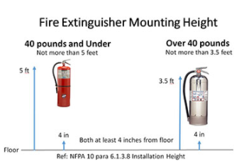
Mounting Fire Extinguishers
Notes:
One or more fire extinguishers, rated not less than 2A, shall be provided on each floor. In multistory buildings, at least one fire extinguisher shall be located adjacent to stairway.

Slide 5
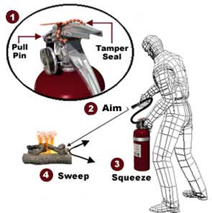
General: Portable Fire Extinguishers
1926.150(c)(1)(i) - Fire extinguisher (type 2A) at 3000 square feet
Half inch hose, less then 100’
One 55-gallon drum with two fire pails
Fire Extinguisher Training - PASS - Fire Safety Training Video
Notes:
A fire extinguisher, rated not less than 2A, shall be provided for each 3,000 square feet of the protected building area, or major fraction thereof. Travel distance from any point of the protected area to the nearest fire extinguisher shall not exceed 100 feet. 1926.150(c)(1)(i)
One 55-gallon open drum of water with two fire pails may be substituted for a fire extinguisher having a 2A rating. 1926.150 (c)(1)(i)
A 1/2-inch diameter garden-type hose line, not to exceed 100 feet in length and equipped with a nozzle, may be substituted for a 2A-rated fire extinguisher, providing it is capable of discharging a minimum of 5 gallons per minute with a minimum hose stream range of 30 feet horizontally. The garden-type hose lines shall be mounted on conventional racks or reels. The number and location of hose racks or reels shall be such that at least one hose stream can be applied to all points in the area.

Slide 6
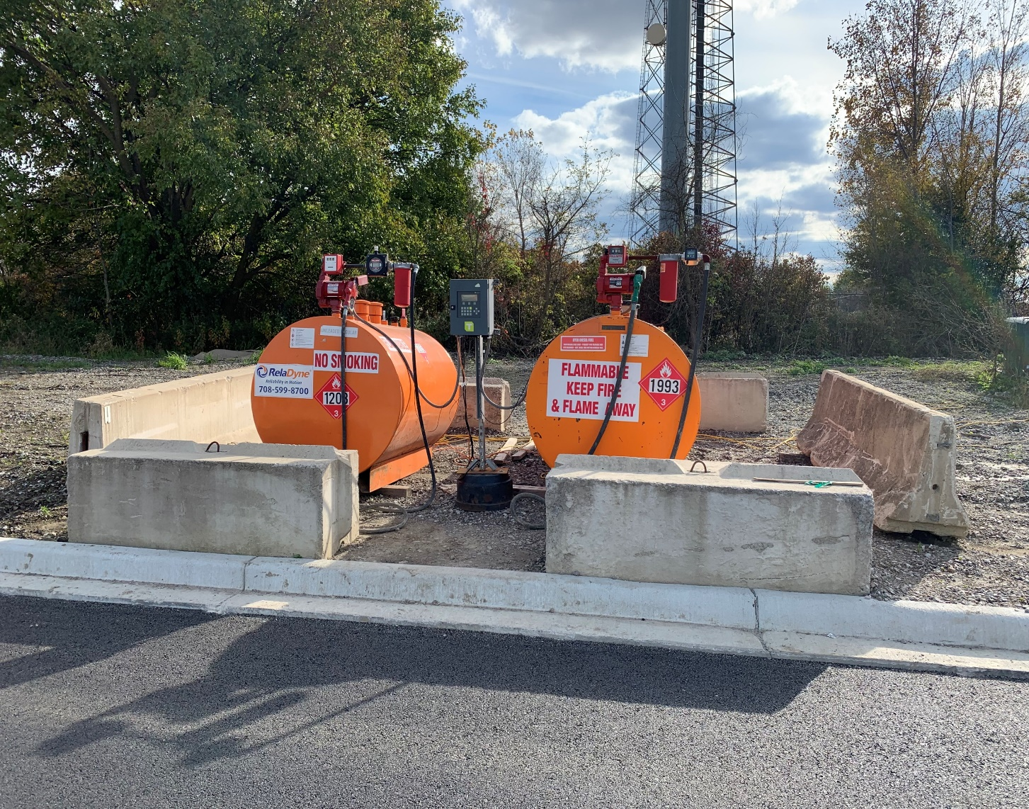
General: Fire Protection for Flammable Liquids
1926.150 (c) (1)(vi)- Fire extinguisher (type 10B) for flammables and flammable gasses of 5 gallons or more
Notes:
A fire extinguisher, rated not less than 10B, shall be provided within 50 feet of wherever more than 5 gallons of flammable or combustible liquids or 5 pounds of flammable gas are being used on the jobsite. This requirement does not apply to the integral fuel tanks of motor vehicles.

Slide 7
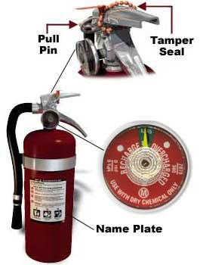
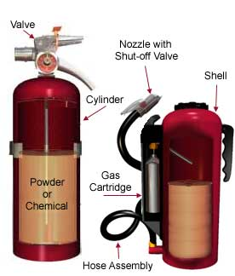
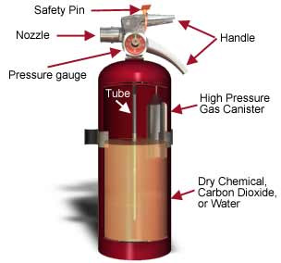
General: Inspection
1926.150(c)(1)(viii) Fire extinguishers must be inspected and maintained
Notes:
Portable fire extinguishers shall be inspected periodically and maintained in accordance with Maintenance and Use of Portable Fire Extinguishers, NFPA No. 10A-1970.
Fire extinguishers which have been listed or approved by a nationally recognized testing laboratory, shall be used to meet the requirements of this subpart.

Slide 8
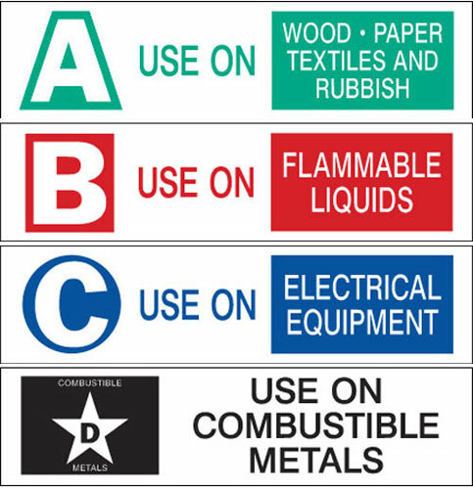
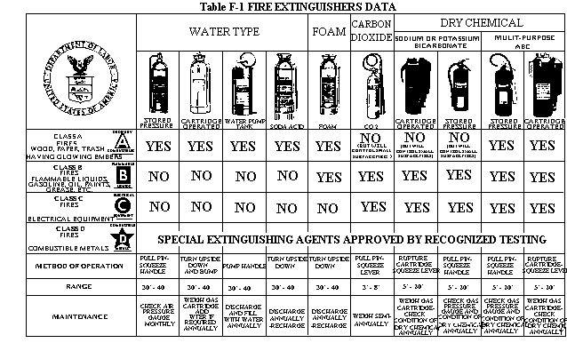
Types of Fire Extinguishers
Notes:
OSHA table F-1

Slide 9
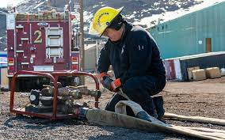
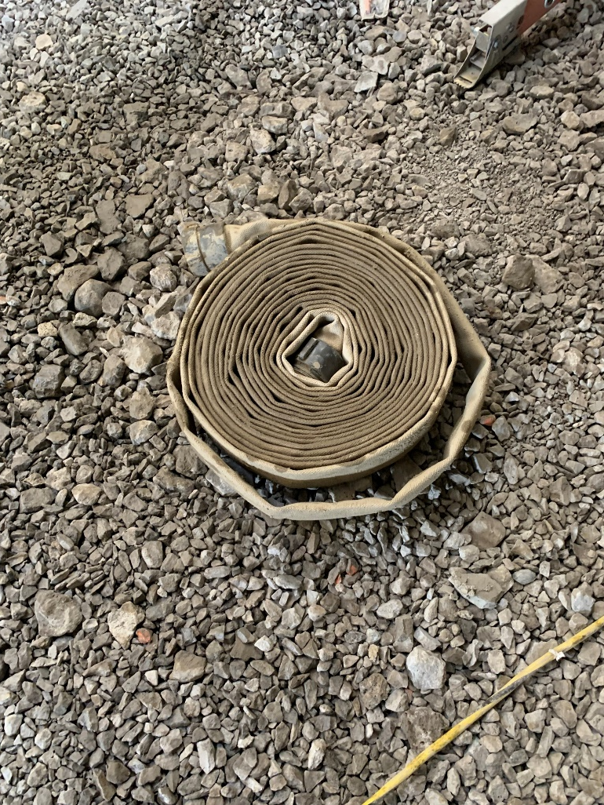
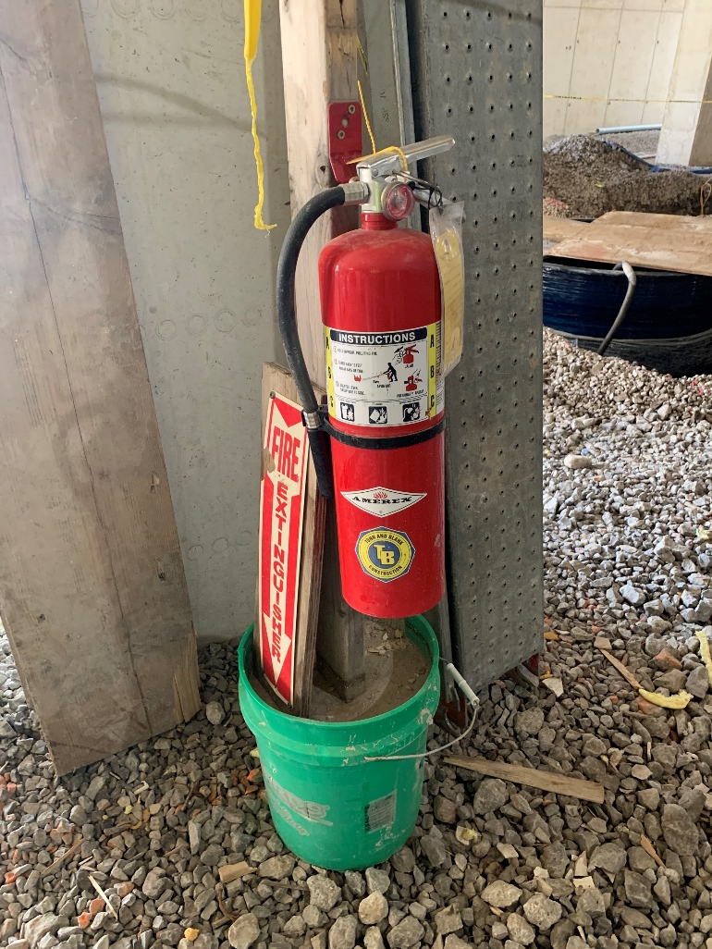
General: Fire Hose Connections
1926 (c)(1)(iii) 1 ½ inch hose with 25 gallons/minute instead of type 2A extinguisher
Notes:
One hundred feet, or less, of 1 1/2-inch hose, with a nozzle capable of discharging water at 25 gallons or more per minute, may be substituted for a fire extinguisher rated not more than 2A in the designated area provided that the hose line can reach all points in the area.
If fire hose connections are not compatible with local firefighting equipment, the contractor shall provide adapters, or equivalent, to permit connections.
During demolition involving combustible materials, charged hose lines, supplied by hydrants, water tank trucks with pumps, or equivalent, shall be made available.

Slide 10
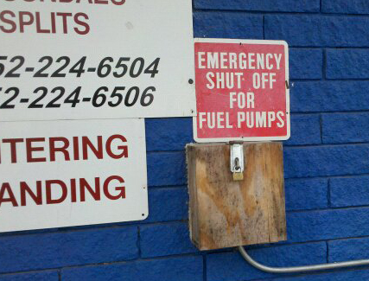
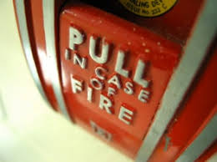
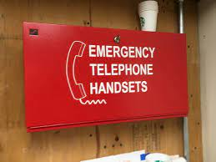
General: Fire Alarm Devices
Alarm Systems must be conspicuous, functional and readily accessible
Notes:
An alarm system, e.g., telephone system, siren, etc., shall be established by the employer whereby employees on the site and the local fire department can be alerted for an emergency.
The alarm code and reporting instructions shall be conspicuously posted at phones and at employee entrances.

Slide 11
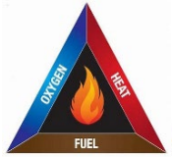
Fire Prevention: Ignition Sources
Electrical
Internal combustion engines
Smoking
Lighting
Other
Notes:
Electrical wiring and equipment for light, heat, or power purposes shall be installed in compliance with the requirements of Subpart K of this part.
Internal combustion engine powered equipment shall be so located that the exhausts are well away from combustible materials. When the exhausts are piped to outside the building under construction, a clearance of at least 6 inches shall be maintained between such piping and combustible material.
Smoking shall be prohibited at or in the vicinity of operations which constitute a fire hazard, and shall be conspicuously posted: "No Smoking or Open Flame.“
Portable battery powered lighting equipment, used in connection with the storage, handling, or use of flammable gases or liquids, shall be of the type approved for the hazardous locations.

Slide 12
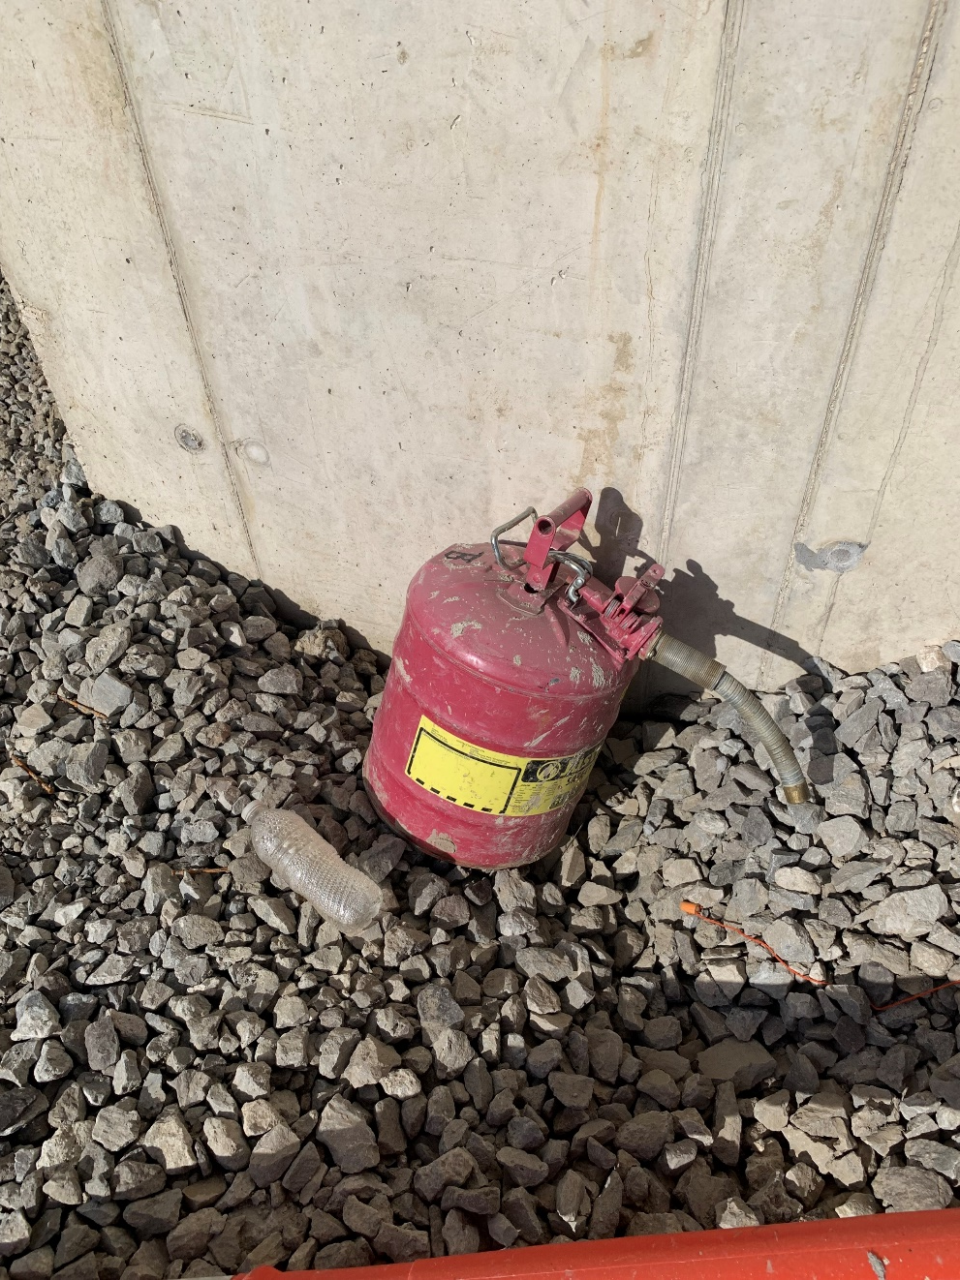
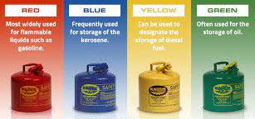
Flammable Liquids
1926.152 (a)(1) Approved containers: “not more than 5 gallons capacity, having a flash arresting screen, spring-closing lid and spout cover and so designed that it will safely relieve internal pressure when subjected to fire exposure”.
Notes:
Only approved containers and portable tanks shall be used for storage and handling of flammable liquids. Approved safety cans or Department of Transportation approved containers shall be used for the handling and use of flammable liquids in quantities of 5 gallons or less, except that this shall not apply to those flammable liquid materials which are highly viscid (extremely hard to pour), which may be used and handled in original shipping containers. For quantities of one gallon or less, the original container may be used, for storage, use and handling of flammable liquids.

Slide 13
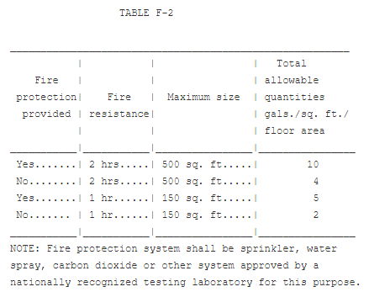
1926.152 (b)(3) Flammable Liquid Storage
Indoor Storage
Limited indoor storage capacity
Storage containers and cabinets must meet applicable NFPA standards
Notes:
Not more than 60 gallons of Category 1, 2 and/or 3 flammable liquids or 120 gallons of Category 4 flammable liquids shall be stored in any one storage cabinet. Not more than three such cabinets may be located in a single storage area. Quantities in excess of this shall be stored in an inside storage room.
Inside storage rooms shall be constructed to meet the required fire-resistive rating for their use. Such construction shall comply with the test specifications set forth in Standard Methods of Fire Test of Building Construction and Material, NFPA 251-1969.

Slide 14
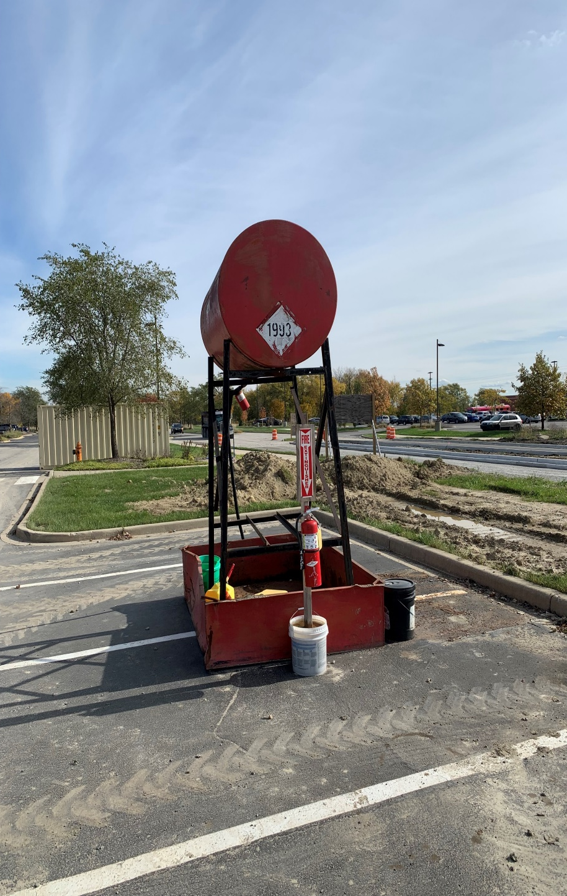
1926.152 (b)(3) Flammable Liquid Storage
Outdoor Storage
20-B units shall be located not less than 25 feet, nor more than 75 feet
Notes:
Storage of containers (not more than 60 gallons each) shall not exceed 1,100 gallons in any one pile or area. Piles or groups of containers shall be separated by a 5-foot clearance. Piles or groups of containers shall not be nearer than 20 feet to a building.
At least one portable fire extinguisher having a rating of not less than 20-B units shall be located not less than 25 feet, nor more than 75 feet, from any flammable liquid storage area located outside.

Slide 15
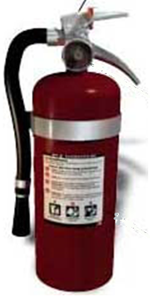
1926.152(c)(1) Flammable Liquid Storage
Within 10’ of door opening where more than 60 gallons of flammable liquids storage
Notes:
At least one portable fire extinguisher, having a rating of not less than 20-B units, shall be located outside of, but not more than 10 feet from, the door opening into any room used for storage of more than 60 gallons of flammable liquids.

Slide 16
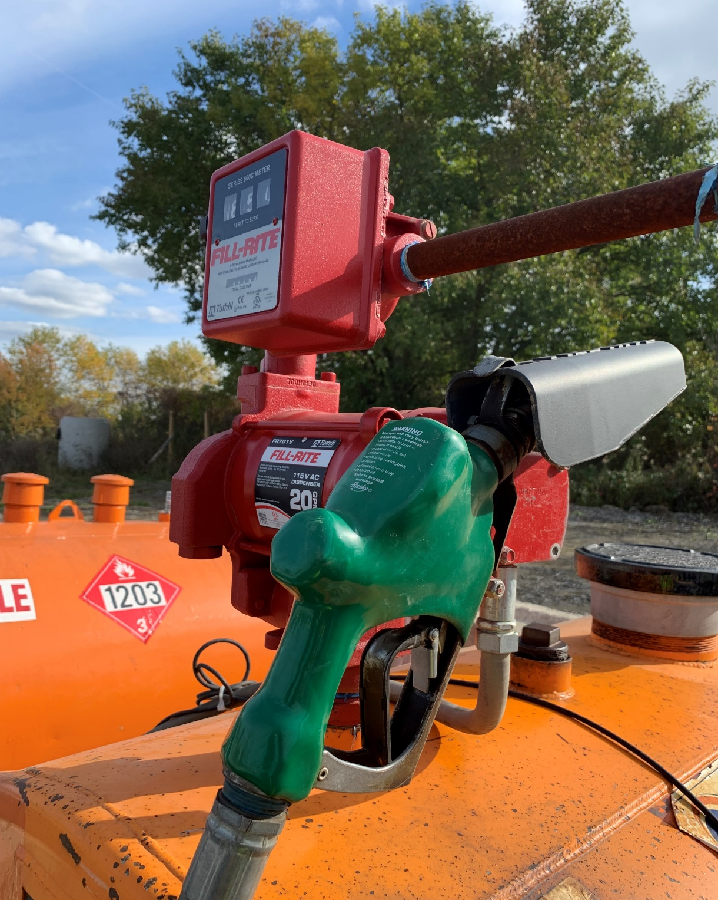
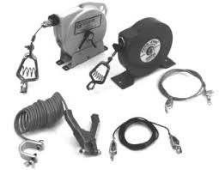
1926.152(e) Flammable Liquids
Dispensing Liquids
Shut Off
Bonding/Grounding
Notes:
Areas in which flammable liquids are transferred at one time, in quantities greater than 5 gallons from one tank or container to another tank or container, shall be separated from other operations by 25-feet distance or by construction having a fire resistance of at least 1 hour. Drainage or other means shall be provided to control spills. Adequate natural or mechanical ventilation shall be provided to maintain the concentration of flammable vapor at or below 10 percent of the lower flammable limit.
Transfer of Category 1, 2, or 3 flammable liquids from one container to another shall be done only when containers are electrically interconnected (bonded).

Slide 17
Dust Explosion - CSB Video
CSB Combustible Dust: Solutions Delayed
Notes:
Chemical Safety Board (CSB) Video

Slide 18
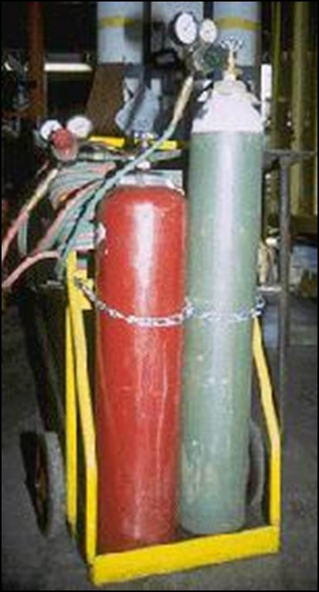
1926.350(a) Welding and Cutting
In-house Transportation
Regulators Removed
Valves Must be closed
Valve Caps on
Secure Cylinders in Cylinder cart
Use platforms or cradles upright and secured
Do not Drag or Drop
No lifting by valve cap
Notes:
Transporting, moving, and storing compressed gas cylinders.
Valve protection caps shall be in place and secured.
When cylinders are hoisted, they shall be secured on a cradle, slingboard, or pallet. They shall not be hoisted or transported by means of magnets or choker slings.
Cylinders shall be moved by tilting and rolling them on their bottom edges. They shall not be intentionally dropped, struck, or permitted to strike each other violently.
When cylinders are transported by powered vehicles, they shall be secured in a vertical position.

Slide 19
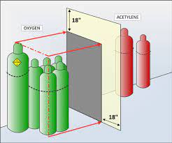
1926.350 (b) Gas Welding and Cutting
Cylinders containing oxygen or acetylene, or other fuel gas shall not be taken into confined spaces.
Notes:
Cylinders shall be kept far enough away from the actual welding or cutting operation so that sparks, hot slag, or flame will not reach them. When this is impractical, fire-resistant shields shall be provided.
Cylinders shall be placed where they cannot become part of an electrical circuit. Electrodes shall not be struck against a cylinder to strike an arc.
Fuel gas cylinders shall be placed with valve end up whenever they are in use. They shall not be placed in a location where they would be subject to open flame, hot metal, or other sources of artificial heat.
Cylinders containing oxygen or acetylene, or other fuel gas shall not be taken into confined spaces.

Slide 20
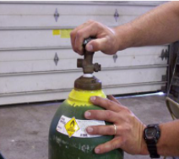
1926.350(d) Gas Welding and Cutting
“Cracking” a cylinder refers to opening the valve slightly and closing it quickly to blow out dust or dirt from the valve outlet. Always wear PPE, use two hands when doing this and always stand to the side of the valve.
Notes:
Use of fuel gas. The employer shall thoroughly instruct employees in the safe use of fuel gas, as follows:
Before a regulator to a cylinder valve is connected, the valve shall be opened slightly and closed immediately. (This action is generally termed "cracking" and is intended to clear the valve of dust or dirt that might otherwise enter the regulator.) The person cracking the valve shall stand to one side of the outlet, not in front of it. The valve of a fuel gas cylinder shall not be cracked where the gas would reach welding work, sparks, flame, or other possible sources of ignition.
The cylinder valve shall always be opened slowly to prevent damage to the regulator. For quick closing, valves on fuel gas cylinders shall not be opened more than 1 1/2 turns. When a special wrench is required, it shall be left in position on the stem of the valve while the cylinder is in use so that the fuel gas flow can be shut off quickly in case of an emergency. In the case of manifolded or coupled cylinders, at least one such wrench shall always be available for immediate use. Nothing shall be placed on top of a fuel gas cylinder, when in use, which may damage the safety device or interfere with the quick closing of the valve.
Fuel gas shall not be used from cylinders through torches or other devices which are equipped with shutoff valves without reducing the pressure through a suitable regulator attached to the cylinder valve or manifold.
Before a regulator is removed from a cylinder valve, the cylinder valve shall always be closed and the gas released from the regulator.
If, when the valve on a fuel gas cylinder is opened, there is found to be a leak around the valve stem, the valve shall be closed and the gland nut tightened. If this action does not stop the leak, the use of the cylinder shall be discontinued, and it shall be properly tagged and removed from the work area. In the event that fuel gas should leak from the cylinder valve, rather than from the valve stem, and the gas cannot be shut off, the cylinder shall be properly tagged and removed from the work area. If a regulator attached to a cylinder valve will effectively stop a leak through the valve seat, the cylinder need not be removed from the work area.
If a leak should develop at a fuse plug or other safety device, the cylinder shall be removed from the work area.

Slide 21
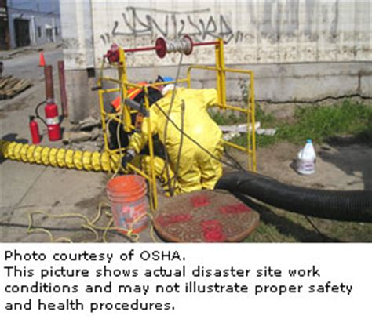
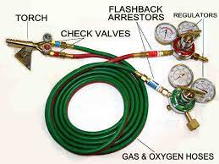
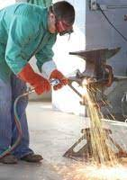
1926.350(f) Gas Welding and Cutting
Fuel gas hose protection and backflow suppression
Notes:
Fuel gas hose and oxygen hose shall be easily distinguishable from each other. The contrast may be made by different colors or by surface characteristics readily distinguishable by the sense of touch. Oxygen and fuel gas hoses shall not be interchangeable. A single hose having more than one gas passage shall not be used.
When parallel sections of oxygen and fuel gas hose are taped together, not more than 4 inches out of 12 inches shall be covered by tape.
All hose in use, carrying acetylene, oxygen, natural or manufactured fuel gas, or any gas or substance which may ignite or enter into combustion, or be in any way harmful to employees, shall be inspected at the beginning of each working shift. Defective hose shall be removed from service.
Hose which has been subject to flashback, or which shows evidence of severe wear or damage, shall be tested to twice the normal pressure to which it is subject, but in no case less than 300 p.s.i. Defective hose, or hose in doubtful condition, shall not be used.
Hose couplings shall be of the type that cannot be unlocked or disconnected by means of a straight pull without rotary motion.
Boxes used for the storage of gas hose shall be ventilated.
Hoses, cables, and other equipment shall be kept clear of passageways, ladders and stairs.

Slide 22
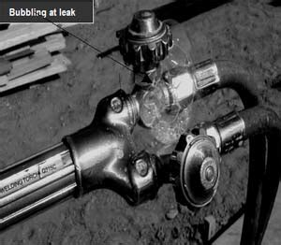
1926.350(g) Gas Welding and Cutting
Damaged and malfunctioning cutting torches, vales and lines are obvious sources of unintended ignition
Light torches from approved devices
Notes:
Clogged torch tip openings shall be cleaned with suitable cleaning wires, drills, or other devices designed for such purpose.
Torches in use shall be inspected at the beginning of each working shift for leaking shutoff valves, hose couplings, and tip connections. Defective torches shall not be used.
Torches shall be lighted by friction lighters or other approved devices, and not by matches or from hot work.
Regulators and gauges. Oxygen and fuel gas pressure regulators, including their related gauges, shall be in proper working order while in use.

Slide 23
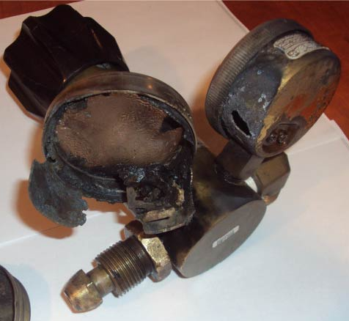
1926.350 (i) Welding and Cutting
Oxygen under pressure and hydrocarbons (oil and grease) can react violently, resulting in explosions, fire, and injury to personnel and damage to property. Never allow oil or grease to come into contact with oxygen under pressure.
Notes:
Oil and grease hazards. Oxygen cylinders and fittings shall be kept away from oil or grease. Cylinders, cylinder caps and valves, couplings, regulators, hose, and apparatus shall be kept free from oil or greasy substances and shall not be handled with oily hands or gloves. Oxygen shall not be directed at oily surfaces, greasy clothes, or within a fuel oil or other storage tank or vessel.
For additional details not covered in this subpart, applicable technical portions of American National Standards Institute, Z49.1-1967, Safety in Welding and Cutting, shall apply.

Slide 24
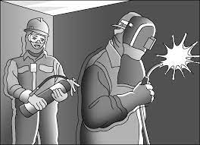
1910.252 and 1926.352 (e) Fire Watch Responsibilities
Fire watchers shall have fire extinguishing equipment readily available and be trained in its use.
They shall be familiar with facilities for sounding an alarm in the event of a fire.
They shall watch for fires in all exposed areas, try to extinguish them only when obviously within the capacity of the equipment available, or otherwise sound the alarm.
A fire watch shall be maintained for at least a half hour after completion of welding or cutting operations to detect and extinguish possible smoldering fires.
Notes:
1910.252(a)(2)(iii)(A)
Fire watchers shall be required whenever welding or cutting is performed in locations where other than a minor fire might develop, or any of the following conditions exist:
1910.252(a)(2)(iii)(A)(1)
Appreciable combustible material, in building construction or contents, closer than 35 feet (10.7 m) to the point of operation.
1910.252(a)(2)(iii)(A)(2)
Appreciable combustibles are more than 35 feet (10.7 m) away but are easily ignited by sparks.
1910.252(a)(2)(iii)(A)(3)
Wall or floor openings within a 35-foot (10.7 m) radius expose combustible material in adjacent areas including concealed spaces in walls or floors.
1910.252(a)(2)(iii)(A)(4)
Combustible materials are adjacent to the opposite side of metal partitions, walls, ceilings, or roofs and are likely to be ignited by conduction or radiation.
1910.252(a)(2)(iii)(B)
Fire watchers shall have fire extinguishing equipment readily available and be trained in its use. They shall be familiar with facilities for sounding an alarm in the event of a fire. They shall watch for fires in all exposed areas, try to extinguish them only when obviously within the capacity of the equipment available, or otherwise sound the alarm. A fire watch shall be maintained for at least a half hour after completion of welding or cutting operations to detect and extinguish possible smoldering fires.

Slide 25
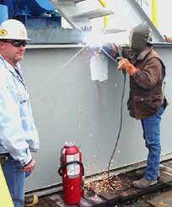
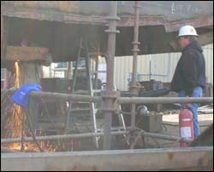
Fire Protection for Hot Work
Notes:
When the welding, cutting, or heating operation is such that normal fire prevention precautions are not sufficient, additional personnel shall be assigned to guard against fire while the actual welding, cutting, or heating operation is being performed, and for a sufficient period of time after completion of the work to ensure that no possibility of fire exists. Such personnel shall be instructed as to the specific anticipated fire hazards and how the firefighting equipment provided is to be used.
When welding, cutting, or heating is performed on walls, floors, and ceilings, since direct penetration of sparks or heat transfer may introduce a fire hazard to an adjacent area, the same precautions shall be taken on the opposite side as are taken on the side on which the welding is being performed.
For the elimination of possible fire in enclosed spaces as a result of gas escaping through leaking or improperly closed torch valves, the gas supply to the torch shall be positively shut off at some point outside the enclosed space whenever the torch is not to be used or whenever the torch is left unattended for a substantial period of time, such as during the lunch period. Overnight and at the change of shifts, the torch and hose shall be removed from the confined space. Open end fuel gas and oxygen hoses shall be immediately removed from enclosed spaces when they are disconnected from the torch or other gas-consuming device.
Except when the contents are being removed or transferred, drums, pails, and other containers which contain or have contained flammable liquids shall be kept closed. Empty containers shall be removed to a safe area apart from hot work operations or open flames.
Drums containers, or hollow structures which have contained toxic or flammable substances shall, before welding, cutting, or heating is undertaken on them, either be filled with water or thoroughly cleaned of such substances and ventilated and tested. For welding, cutting and heating on steel pipelines containing natural gas, the pertinent portions of regulations issued by the Department of Transportation, Office of Pipeline Safety, 49 CFR Part 192, Minimum Federal Safety Standards for Gas Pipelines, shall apply.

Slide 26
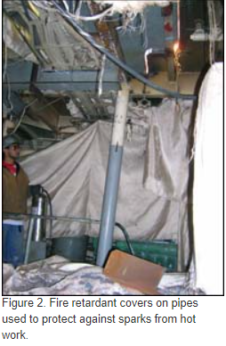
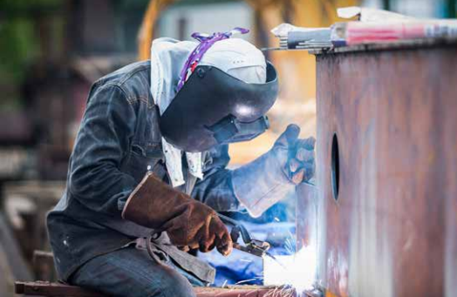
Hot Work in Industrial Construction
Steel Mills
Power Plants
Process Safety Management
Refineries
Chemical Plants
Notes:
Site safety rules may be more stringent

Slide 27
Hot Work Permit
Ensure all affected personnel are on the same page.
Construction
Renovation
Repairs
Maintenance
Notes:
The Hot Work Permit system is intended to assure that the individuals involved in construction, renovation, repairs and maintenance are aware of the hazards associated with hot work and welding and that they implement control measures to help mitigate them.

Slide 28
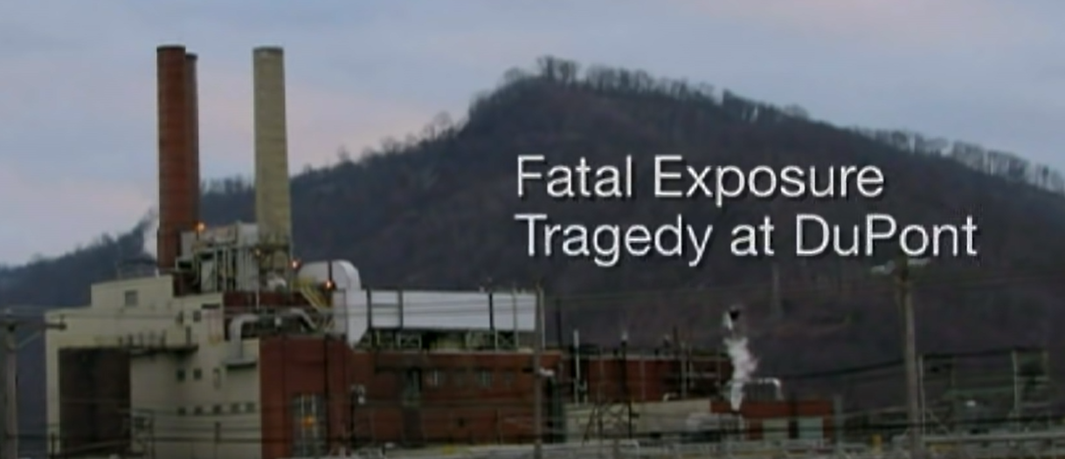
Cold Cutting Steel - CSB Video
Fatal Exposure: Tragedy at DuPont
Notes:
Chemical Safety Board (CSB) Video

Slide 29
Testing for Explosive Gases
Follow the manufacturer's guidelines for proper calibration
Only use a certified traceable test gas
Train operators on the proper methods of calibration
Notes:
The primary reason for proper, regular instrument calibration is to provide accurate gas-concentration readings that could prevent worker illness, injury, or death. Correctly calibrating an instrument helps to ensure that the DRPGM will respond accurately to the gases it is designed to detect, thereby warning users of hazardous conditions before the conditions reach dangerous levels. Some DRPGMs have two levels of alarms – warning and danger. The warning alarm alerts the operator and workers that the work environment has a detectable elevated concentration of toxic gas and is, therefore, potentially hazardous. The danger alarm indicates that the toxic-gas concentration exceeds the programmed hazard threshold, and that the toxic gas in the work area is above the warning level and approaching a hazardous level. Whether a DRPGM provides a warning or danger alarm at the proper concentration depends on its detection capabilities, its ability to translate its findings into an accurate reading, and the presence of interfering gases (see "Calibration Drift and Causes" above).

Slide 30
Gas Explosion – CSB Safety Video
Dangers of Hot Work
Notes:
Chemical Safety Board (CSB) Video

Slide 31
Worker Rights and Employer Responsibilities and Employer Responsibilities and Employer Responsibilities
A safe and healthful workplace
Know about hazardous chemicals
Information about injuries and illnesses in your workplace
Complain or request hazard correction from employer
Training
Hazard exposure and medical records
File a complaint with OSHA
Participate in an OSHA inspection
Be free from retaliation for exercising safety and health rights whistleblower protection Section 11c
Employer rights and responsibilities
Notes:
OSHA Workers rights information

Slide 32
Trainer Preparation
Participants are briefed on affective instructional approaches and use of visual aids and handouts. This course allows the student to become a trainer in the Silica training program
Participants who wish to participate as authorized CAF Silica instructors will have successfully completed the following;
Successfully pass the exit exam
Demonstrates an understanding of the course material
Demonstrate the ability to present the CAF Silica course material
Participant must prepare a presentation on an assigned CAF SSC topic

Slide 33
More Information Visit: WWW.OSHA.Gov/Fire-safety
Notes:
More information follow the above link

Slide 34
OSHA Videos/Hands on Modules
Portable Fire Extinguishers - https://www.youtube.com/watch?v=ktrv34zW7-A
Static Electricity as an Ignition Source – CSB Video https://youtu.be/tVZzdtnZaJk
CSB Combustible Dust: Solutions Delayed - https://youtu.be/ADK5doMk3-k
E. I. Du Ponte De Nemours Co. Fatal Hot Work Explosion – CSB Video -https://www.youtube.com/watch?v=ISNGimMXL7M&feature=emb_rel_end
Cold Cutting Steel - CSB Video https://www.youtube.com/watch?v=ISNGimMXL7M&feature=emb_rel_end
Gas Explosion – CSB Safety Video https://youtu.be/zWkcuR0adeI

Slide 35
Reserved
Reserved

