Slide 1

Mental Health and Suicide in Construction Train-the-Trainer
This material was produced under grant number SH-000002-SH3 from the Occupational Safety and Health Administration, U.S. Department of Labor. It does not necessarily reflect the views or policies of the U.S. Department of Labor, nor does mention trade names, commercial products, or organizations imply endorsement by the U.S. Government.

Slide 2
Section 1
Is this an issue in construction?
Notes:
Section 1 is intended to identify the depth of the issue within the construction industry.

Slide 3
Orientation to the Topic
Is mental health and issue in the construction industry?
Is suicide an issue in the construction industry?
Have you seen any mental health or suicides in the industry?
Are managers aware of mental heal and suicide issues?
Does your company have a program or response to address mental health or suicide?
Have you done internal training within your organization?
Where does your organization get help?
How are employees directed to get help?
What should we be doing organizationally?

Slide 4
Whats your Perception?
Recent surveys have suggested that 64% of construction workers want better support for their physical health, mental health and overall wellbeing, with calls coming from within for the industry to have a better awareness of mental health.
The construction industry is male dominated, and the perception that the men who work within it are ‘tough’.
Notes:
This slide is intended to initiate conversation related to the topic of suicide in the workplace. The target audience, construction personnel my not considure this an issue with our industry

Slide 5
What do we know about the suicide problem?
In 2020, there were 45,979 deaths by suicide in the United States, which is about 1 suicide every 11 minutes.¹ Suicide was the:
  2nd leading cause of death among people 10 to 34 years of age
  4th leading cause of death among people 35 to 44 years of age
  7th leading cause of death among people 45 to 54 years of age
  9th leading cause of death among people 55 to 64 years of age
Notes:
These statistics are available on the CDC Website https://www.cdc.gov/suicide/facts/index.html

Slide 6
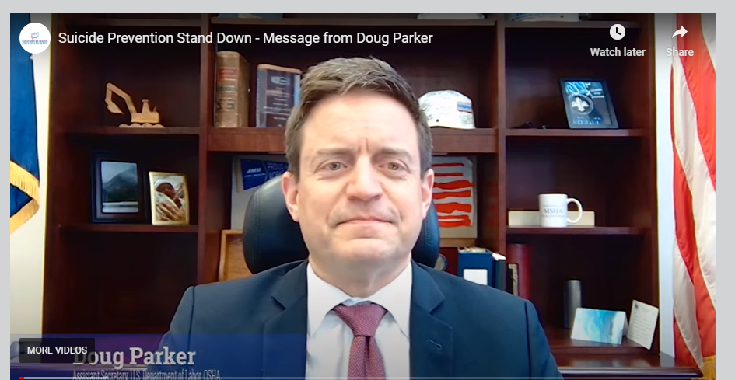
Notes:
Assistant Secretary Doug Parker speaks about the importance of suicide prevention and breaking the stigma around mental health in construction ahead of Construction Suicide Prevention Week 2022. For more information about the CSPW initiative, visit www.constructionsuicideprevention.com

Slide 7
Perception Survey Summary Purdue Northwest, Northwest Indiana Business Roundtable and Construction Advancement Foundation
Survey result for businesses
Employers believe suicide prevention is important however, they are unsure how to address with workers
Employers report they need to do more on suicide prevention
Employers do not have program targeting suicide prevention
Employers believe employees will not come seek suicide assistance
Survey results for workers
Workers don't think suicide is an issue at workplace
Workers are not exposed to suicide issues during apprenticeship period
Workers are not aware of suicide prevention resources
Workers do not want to discuss suicide related topics with supervisors
Notes:
These statistics are provided by XXXXXXXXXXXXX??

Slide 8
The Construction Industry is at High Risk for Suicide
Each year, self-inflicted injury accounts for 836,000 emergency department visits
More people die from suicide than from motor vehicle crashes
Men in high skill and high stakes occupations (i.e. supervisors of heavy construction equipment) are almost 1.5 times more likely to die by suicide
People in occupations requiring no education after high school are more at risk for suicide
Notes:
Content provided by National Action Alliance for Suicide Prevention

Slide 9
Construction Industry Statistics
Men out-pace women four to one in suicide deaths and white working-age men have the highest suicide rates. However, among women, workers with the highest suicide rates were in construction and extraction (134.3 per 100,000).
The construction industry is in the top nine occupations at risk for suicide.
Notes:
Information provided by Construction Working Minds https://www.constructionworkingminds.org/industry-risks

Slide 10
Why are suicide rates high in construction?
Male dominated industry
Strength, determination, grit –the same traits that can be a barrier to asking for help for mental health concerns
Access to lethal means – firearms, tall places, pills
Chronic pain from hard, physical labor
Higher rates of drug and alcohol abuse
Shift work or non-traditional hours, sleep disruption, and depression
Financial stress; no work no pay, lack of paid leave
Time away from families, relationship stress, lack of support
Multi-employer work structure
Competitive and high-pressure work environment

Slide 11
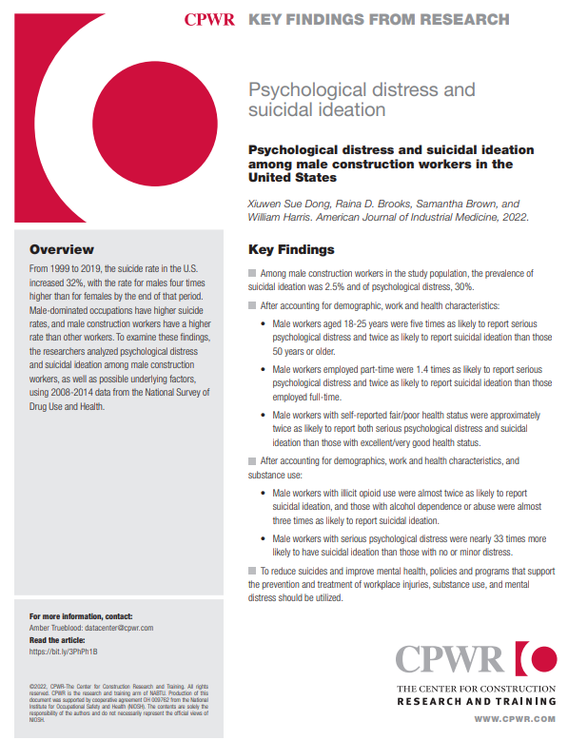
Mental Health in Construction
Statistically the construction industry ranks highest in reported workers suffering with mental health issues and one of the highest rates of suicide by occupation in the U.S.
The construction industry demonstrates how differently society views physical and mental health
Notes:
CWPR Key Findings from Research - https://www.cpwr.com/wp-content/uploads/KF2022-psychological-distress-suicidal-ideation.pdf

Slide 12
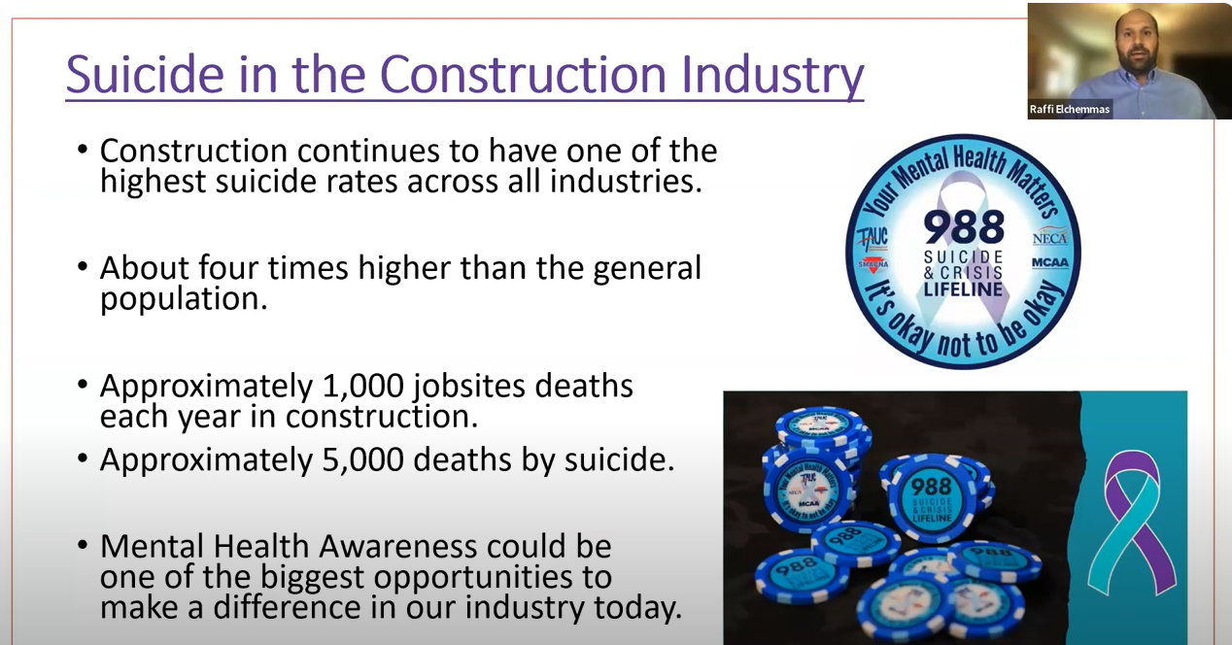
Suicide in the Construction Industry
Full 1:15 Video
Notes:
69 views Sep 14, 2023 CPWR Informational Webinars
CPWR-MCAA-NECA-SMACNA-TAUC Webinar Wednesday, September 13th Slides available at https://www.cpwr.com/wp-content/uploa.... Studies show that suicide is killing workers in the construction industry at five times the rate of work-related injuries like falls and struck-by incidents. And it’s killing them in all parts of the industry – including upper management. Unfortunately, there is no simple answer to why this is happening nor is there an easy fix, but in many cases deaths from suicide CAN be prevented when we push mental health stigma aside and help one another. We will be joined on this webinar by a representative from NASCAR driver Daniel Dye’s race team and the Race to Stop Suicide for a conversation about real issues affecting us every day and ways to spot signs of depression or feelings of hopelessness in colleagues, employees, and loved ones. In addition, our panelists will share their own experiences with mental health, engaging in suicide prevention activities in the workplace, and breaking down barriers in an industry that does not always welcome conversations about feelings. Employers and other attendees will walk away with ideas to help reduce stigma and save lives and will learn more about mental health resources for the construction industry. Moderator: Chris Trahan Cain, CIH, Executive Director, CPWR – The Center for Construction Research and Training Panelists: Raffi F. Elchemmas, Executive Director, Safety, Health and Risk Management, Mechanical Contractors Association of America (MCAA) Alexander M. Kopp, Director of Environmental Health and Safety, The Association of Union Constructors (TAUC) Randy Dye, Chairman, Race to Stop Suicide Kevin Striegle, Manager, Daniel Dye Racing & Race to Stop Suicide Justin Crandol, MS, CSP, ARM, CRIS, Director of Safety, Sheet Metal and Air Conditioning Contractors’ National Association (SMACNA) Wesley L. Wheeler, SMS, CESCP, Executive Director of Safety, National Electrical Contractors Association (NECA). Board Member, Construction Industry Alliance for Suicide Prevention (CIASP) Justin Azbill, Director, National Environment, Health, and Safety, Milwaukee Tool. Board Member, Construction Industry Alliance for Suicide Prevention (CIASP)

Slide 13
Section 2
I can handle it myself!
Notes:
Section 2 is intended to provide insight to address how the problem may take resources to address

Slide 14
Suffering in Silence
Many workers reported felling forced to “deal with it,” choosing not to seek the help they need, resulting in worsening symptoms.
Counteracting this challenge requires the mental health of your workforce needs to be prioritized, like workplace safety issues.

Slide 15
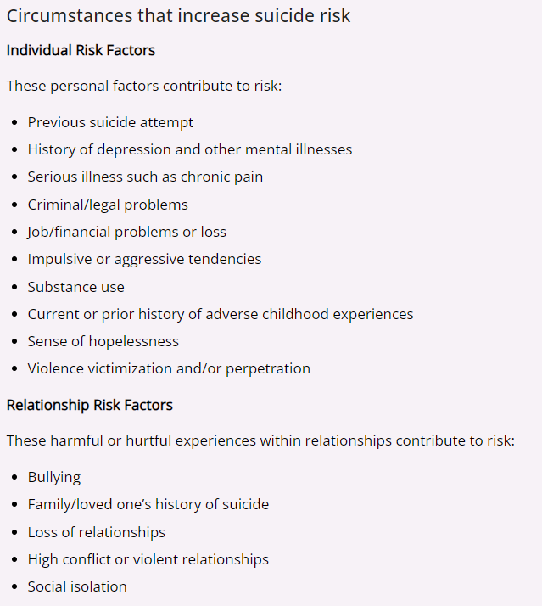
Circumstances that increase suicide Risk
Notes:
CDC Suicide

Slide 16
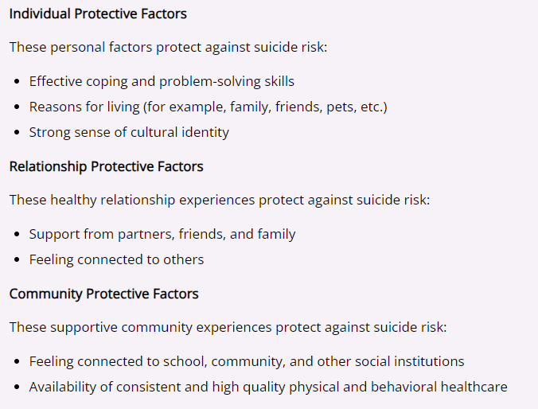
Circumstances that protect against suicide Risk
Notes:
CDC Suicide Prevention
https://www.cdc.gov/suicide/factors/index.html#factors-protect

Slide 17

Self-Care
Video
Sleep
Eat healthy
Schedule time for yourself
Notes:
US Department of Labor Video Suicide Prevention Video

Slide 18
Section 3
How can we tell if a someone is in trouble?
Notes:
Section 3 is intended to facilitate discuss related to identifying systems in coworkers

Slide 19
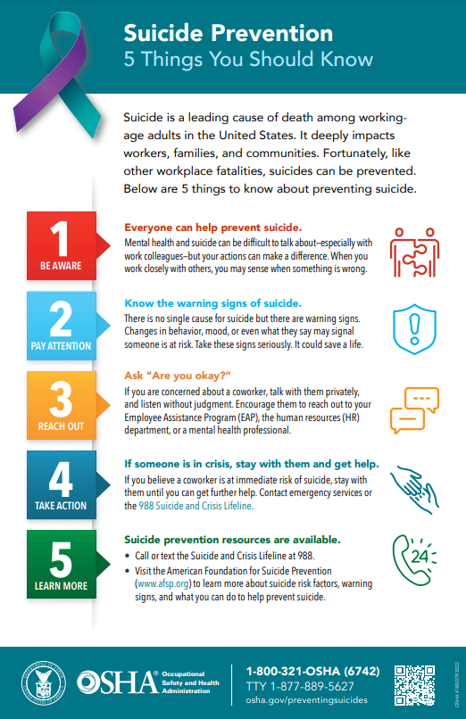
What Can we do to help?
Everyone Can Help
Know the warning Signs
Are You OK?
Stay with someone in Crisis
Learn about the available resources
Notes:
Information provided by US Department of Labor, OSHA Suicide prevention web-site

Slide 20
Warning Signs
Talking about wanting to die or to kill oneself.
  Communication may be veiled, such as: “I just can’t take it anymore.” or
  “What’s the use?”
Looking for ways to kill oneself, such as searching online or seeking access to lethal means.
Talking about feeling hopeless or having no reason to live.
Notes:
Information provided by US Department of Labor, OSHA Suicide prevention web-site

Slide 21
Warning Signs cont.
Talking about feeling trapped or in unbearable pain
Talking about being a burden to others
Increasing the use of alcohol or drugs
Acting uncharacteristically anxious or agitated
Behaving recklessly
Sleeping too little or too much, unusually late for work
Withdrawing or feeling isolated
Showing rage or talking about seeking revenge
Displaying extreme mood swings

Slide 22
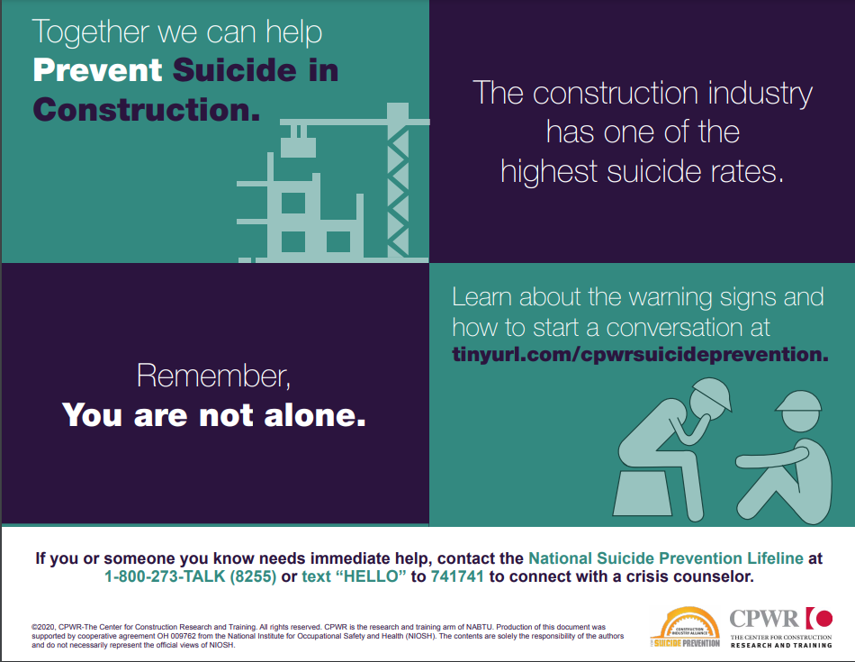
Start a Conversation….
Notes:
Center fpr Worker Protection Start a Conversation Poster - https://www.cpwr.com/wp-content/uploads/suicide_prevention_infographic_1-start_a_conversation.pdf

Slide 23
Section 4
How can we prepare to help?
Notes:
Section 4 is intended to provide potential options for supporting coworker displaying suicide symptoms

Slide 24
How Prepared is your Workplace?
Is wellness a priority?
Does communication offer openness and support?
Is there a stigma for mental health conditions?
Is stress the norm?
Are mental health benefits offered and supported at the same level as other physical disorders?
Are workplace postings available for general local mental health resources?

Slide 25
Protective Factors
Culture that promotes the importance of safety
Emphasis on teamwork
Culture of employee engagement and connectedness, providing a sense of belonging
Culture of wellness that values mental health
Access to insurance and mental health care (e.g., Employee Assistance Program)
Informational support systems (buddy systems)
Leadership and supervisor training

Slide 26
How Prepared is your Workplace (continued)
Does workplace have an Employee Assistance Program or has one but doesn’t promote it to employees?
Does workplace routinely offer educational programs and training on mental health topics?
Does workplace distribute mental health awareness material (brochures/posters/fact sheets)?
Does workplace encourage screening for mental health conditions like depression, anxiety, and substance abuse?
Does workplace have Standard Operating Guide for how best to handle suicide crises?

Slide 27
Changing Organizational Policies and Culture
Changing organizational polices and culture to promote a protective environment for workers, such as:
Promoting prosocial behavior among employees (e.g., asking for help)
Assessing and referring employees to helping services (e.g., mental health, substance abuse treatment, financial counseling)
Developing crisis response plans for post-suicide events

Slide 28
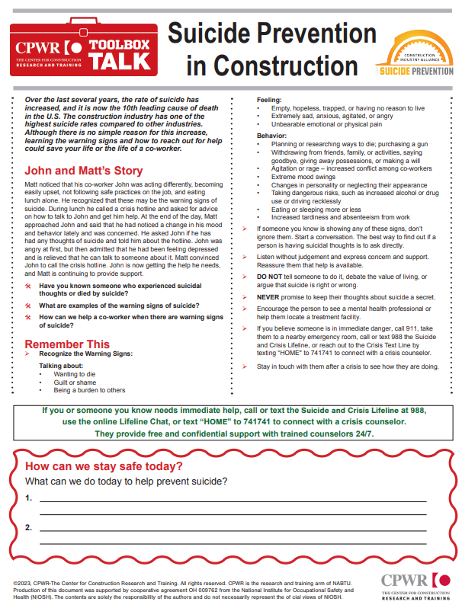
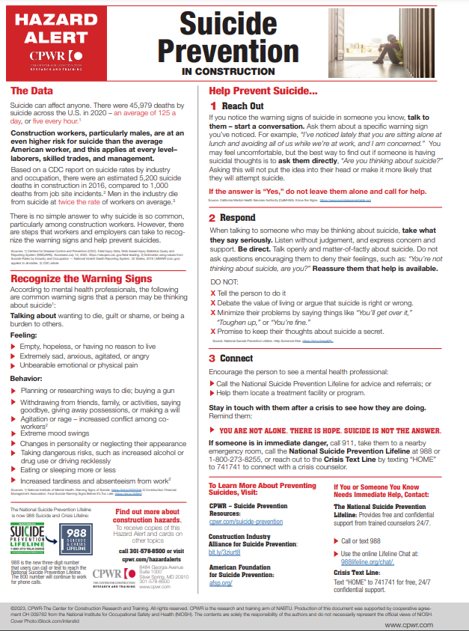
Toolbox Talks?
Notes:
Resource provided by CWPR - https://www.cpwr.com/wp-content/uploads/TT-Suicide-Prevention.pdf

Slide 29
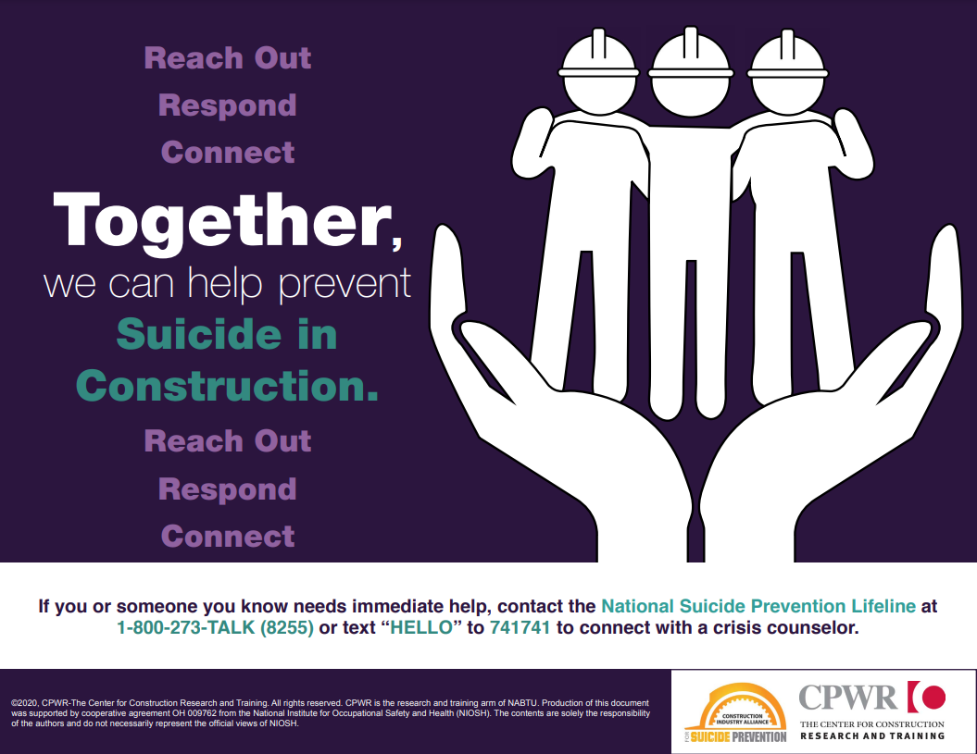
Referring Individuals to Help
We are not medical experts
988
EAP
BCRC/ Perspectives in Indiana
Notes:
CWPR – Resource Page “Reach Out Poster” - https://www.cpwr.com/wp-content/uploads/suicide_prevention_infographic_2-reach_out.pdf

Slide 30
Section 5
We’re all in this together!
Notes:
Section 5 is tended to promote Construction Suicide Prevention Week
Use the resources provided to plan activities with your workers during Suicide Prevention Week and let us know how you participated. Participating companies will receive an OSHA-recognized, industry-endorsed certificate of participation and badge you can display on your website and social media.

Slide 31
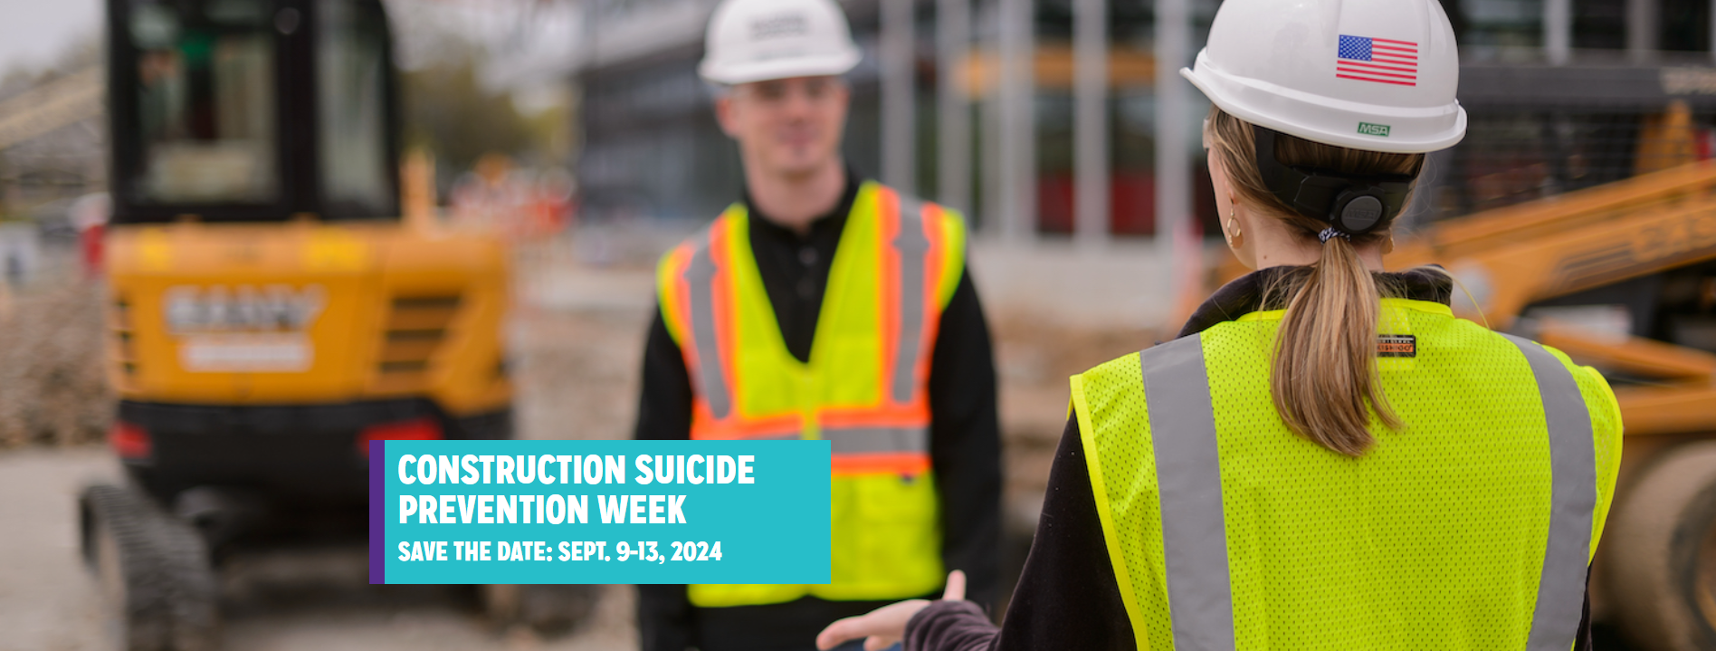
Save the Date

Slide 32
Register to Participate
September 9-13, 2024
REGISTER And PARTICIPATION
Use the resources provided to plan activities with your workers during Suicide Prevention Week and let us know how you participated. Participating companies will receive an OSHA-recognized, industry-endorsed certificate of participation and badge you can display on your website and social media.
In 2022, nearly a quarter million construction workers representing 48 states and territories of the U.S. registered their participation in Construction Suicide Prevention Week via this website. That’s an increase over the more than 68,000 workers from 32 states who participated in 2021. Let’s reach even more people in 2023 to save even more lives.
Notes:
Use the resources provided to plan activities with your workers during Suicide Prevention Week and let us know how you participated. Participating companies will receive an OSHA-recognized, industry-endorsed certificate of participation and badge you can display on your website and social media.

Slide 33
Train-the-Trainer Preparation
Participants are briefed on affective instructional approaches and use of visual aids and handouts. This course allows the student to become a trainer of this training program.
Participants who wish to participate as authorized instructors will have successfully completed the following;
  Successfully pass the exit exam
  Demonstrates an understanding of the course material
  Demonstrate the ability to present the course material
    Participant must prepare a presentation on an assigned topic

Slide 34
OSHA Rights and Responsibilities
  A safe and healthful workplace
  Know about hazardous chemicals
  Information about injuries and illnesses in your workplace
  Complain or request hazard correction from employer
  Training
  Hazard exposure and medical records
  File a complaint with OSHA
  Participate in an OSHA inspection
  Be free from retaliation for exercising safety and health rights whistleblower protection Section 11c
  Employer rights and responsibilities

Slide 35
Thank You

